Slide 1
Splunk

Slide 2
What is Splunk
Splunk is a platform that collects, indexes, and searches data pulled from a network.
Notes:
Teacher Notes:
Splunk is widely used as a SIEM solution (Splunk Enterprise Security) to monitor security events, detect threats, and support incident response
Splunk provides dashboards, alerts, and reports so teams can visualize activity and spot issues in real time or from a incident response angle

Slide 3
Searching in Splunk
When searching in Splunk first you have to specify an index to search data from.
It is common practice to specify an index to refine your search when more than one index exist, this also reduces demand on the SIEM.
i.e index=“host” will return all data within the host index.
Notes:
Teacher notes:
An index in Splunk is like a giant filing cabinet where all your data is stored, organized, and made searchable. It’s a way to categorize and organize your data so that Splunk can quickly find and retrieve it when you need it.

Slide 4
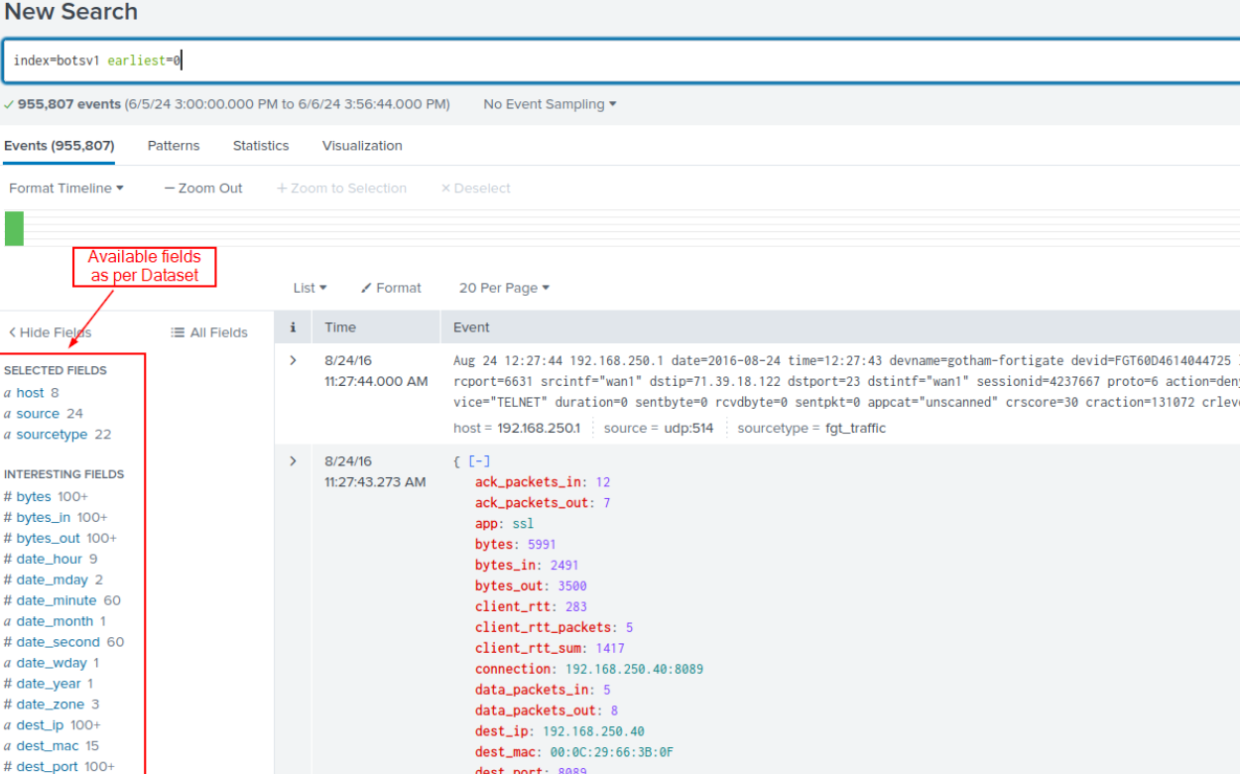
Searching in Splunk - Fields
Fields allow searching, filtering, and analyzing data more efficiently & effectively.
Can think of fields like variables
Notes:
Teacher Notes:
Splunk allows you to create your own fields using regex, useful for grabbing information not already fielded or further filtering information

Slide 5
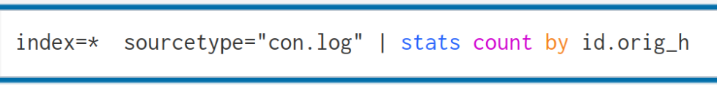
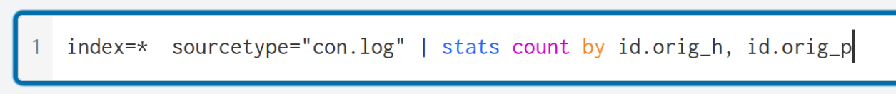
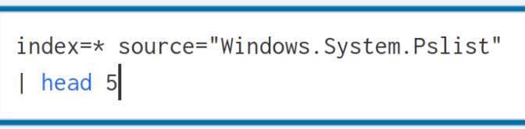
Demo Searches
stats count by source IP
stats count by with source IP and destination IP
latest 5 events of a source type
Notes:
Teacher Notes:
(index=* for demo only, use a specified index in production environment)
The field for source ip may change based on the source the events are extracted from

Slide 6
Searching in Splunk - Tables
Normal source types have too many fields to analyse at once.
With the table function you are able to select which fields you want to view.
Helpful when generating dashboards as you can select only the important fields.
Notes:
Teacher Notes:
A way of refining search results containing only the fields you apply

Slide 7
Logic Operators in Splunk
Logical operators are used in Splunk searches to combine or refine conditions. They make searches more precise and enable more advanced filtering logic.
Common logical operators include AND, OR, and NOT.
AND requires all conditions to be true (e.g., status=200 AND method=POST)
OR allows any one of multiple conditions to be true (e.g., status=200 OR status=404)
NOT excludes certain events from results (e.g., NOT status=200).

Slide 8
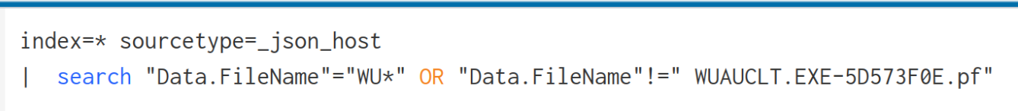
Example Logical Operators
Show any prefetch file which starts WU but not the string WUACLT.EXE…
Notes:
Teacher Note:
!= is the same as DOES NOT EQUAL

Slide 9
Regex in splunk
Splunk allows you to extract your own fields through the use of regex.
This can be useful if you want a field to contain specific events i.e usernames but one doesn’t exist currently.
Notes:
Teacher Notes:
Regex is very useful especially to apply fine filtering or refine searches and can also be used directly in the command line of splunk
If your not strong with regex its okay AI is your best friend.

Slide 10
Baselining
When you setup in a network the first step you conduct is usually a baseline to determine what is and isn’t normal.
A common was you can do this by making CSV of current data and for future searches you compare the output to the original baseline CSV, any new unique events will flag it.
Notes:
Teacher Notes:
A comparison baseline is commonly used as it displays and easily flags anomalies.

Slide 11
Dashboarding in Splunk
Dashboards are commonly used to display critical information quickly and clearly.
Three main uses for dashboards in splunk
Baseline
Drilldown
Alerts
Notes:
Teacher Note:
Baseline dashboards are primarily used to detect what is and isn’t normal.
Drilldown dashboards on important data for further analysis and are very useful in finding artifacts after initial malicious behavior has been detected
Alerts style dashboard are very useful for live or ongoing monitoring.

